Slide 1
International Political Economy

Slide 2
What is the international political economy?
Lesson 1
Section 1.1

Slide 3
Economies in which the relations with foreign plays a prominent role are said to be open.
The analysis of such economies requires that considerable attention be paid to government decisions
Particularly, this role is critical in field as:
  International trade
  Balance of payment and your deficit/surplus
  Fiscal and monetary policy
  Interest rate
  …

Slide 4
The discipline that analyzes the government role in economies is the Political Economy
The discipline that studies how the government decisions have effect with international trade and economic relations with rest of world is named International Political Economy (IPE)

Slide 5
Economics
  Microeconomics (individual decisions and behaviour)
  Macroeconomics (aggregate decisions and collective behaviour)
    Political Economy (economic role of government)
      International Political Economy (economic role of government in international field)

Slide 6
Course Outline
Quantitative Dimensions of Globalization
Budget Deficit and Public Debt
The Balance of Payments
Political economics in Open Economy
Purchasing Power Parity
Interest Rate Parity

Slide 7
Data sources
Lesson 1
Section 1.2

Slide 8
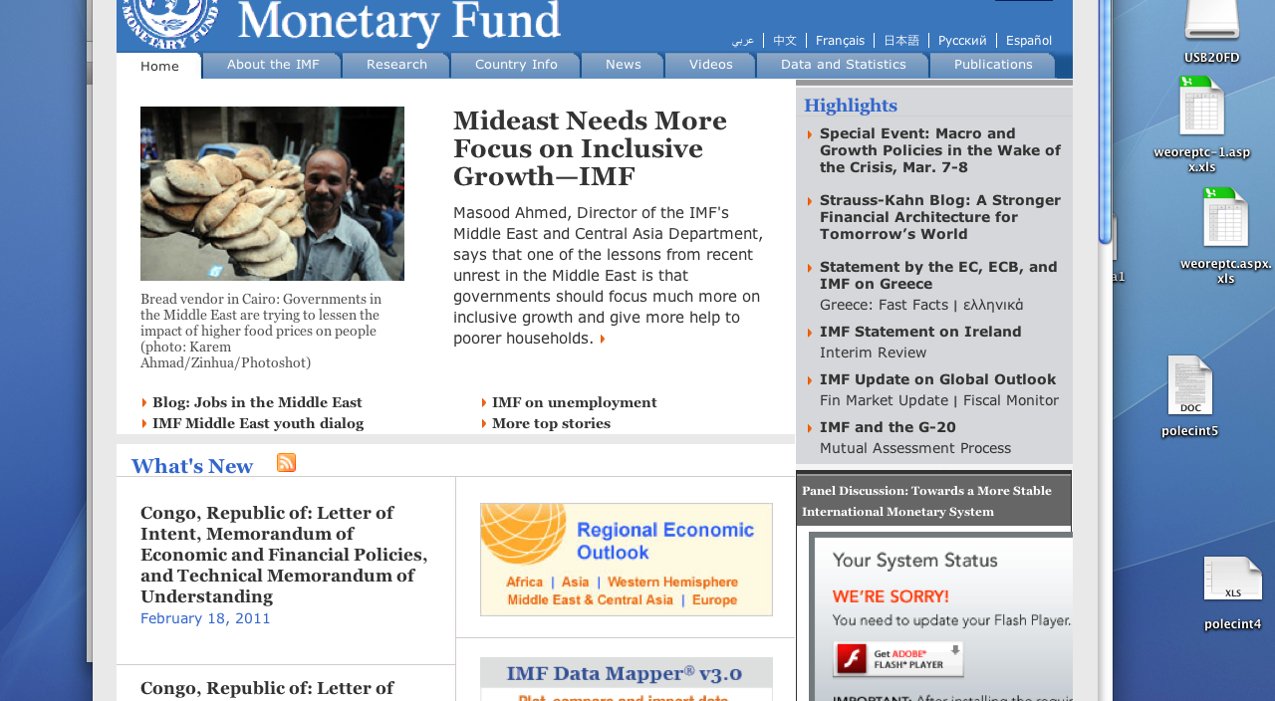
IMF

Slide 9
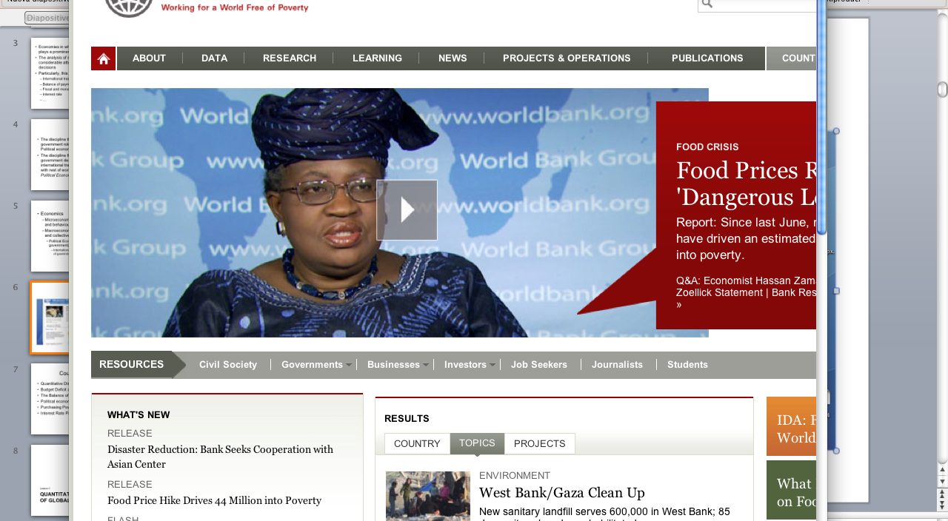
World Bank

Slide 10

OECD

Slide 11
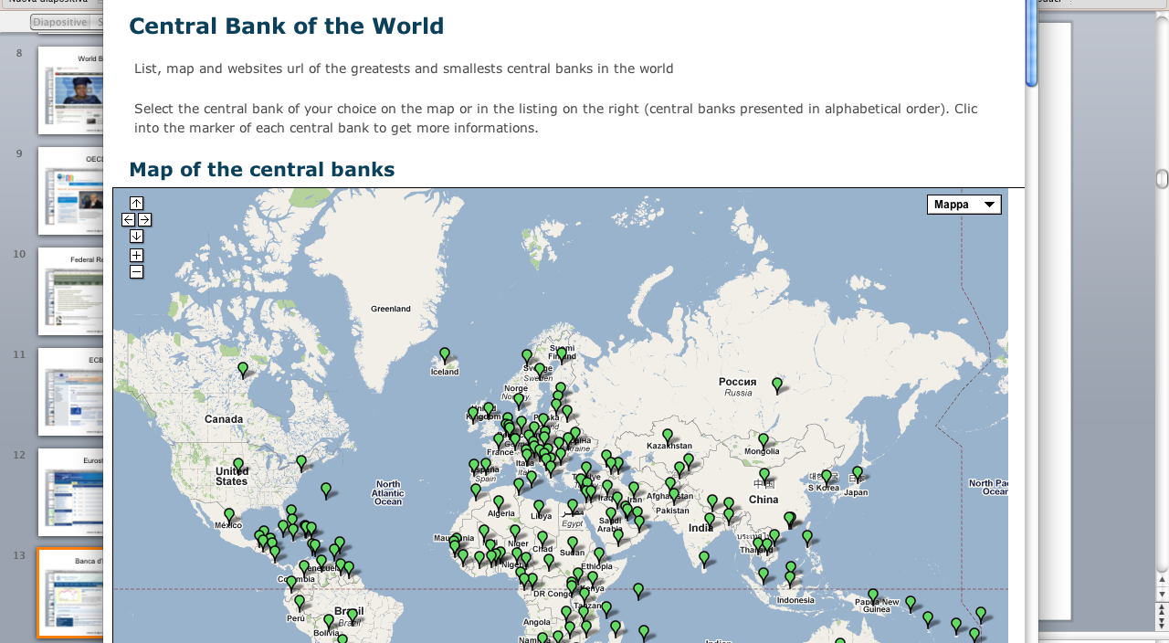
Central Banks
(http://centralbank.monnaie.me/)

Slide 12
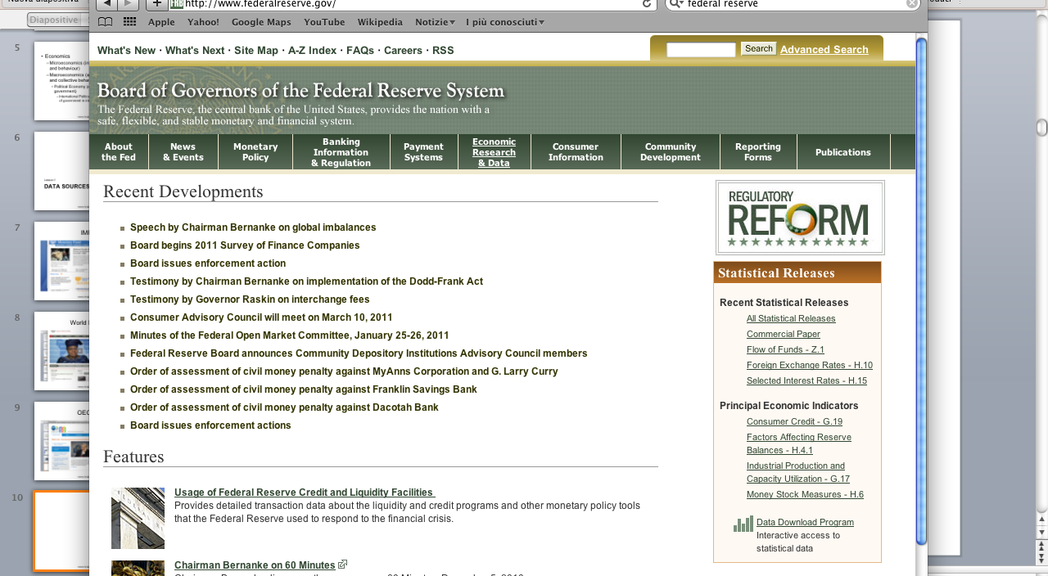
Federal Reserve

Slide 13
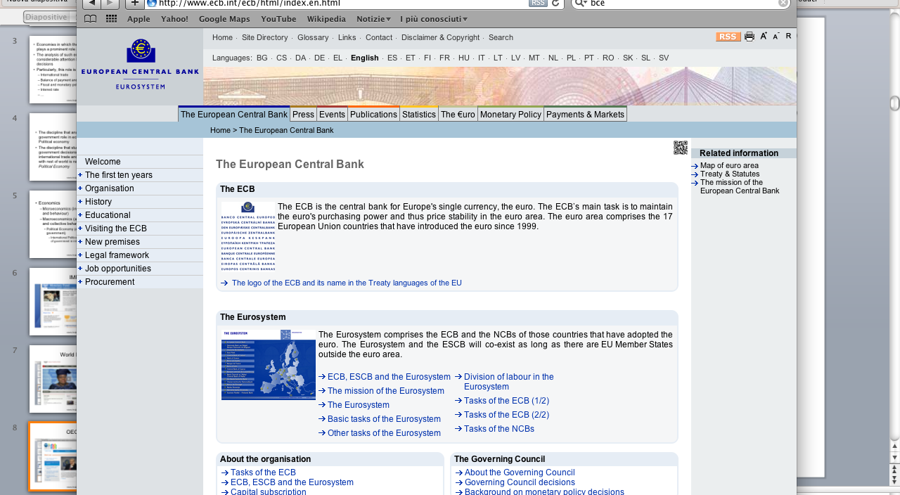
ECB

Slide 14

Eurostat

Slide 15
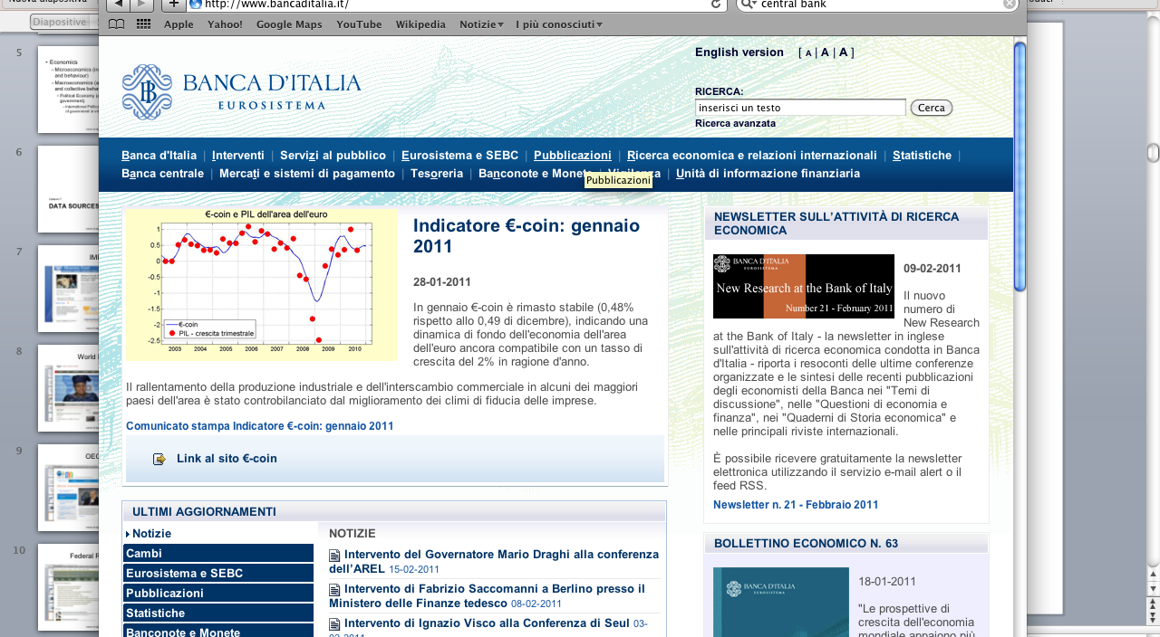
Banca d’Italia

Slide 16
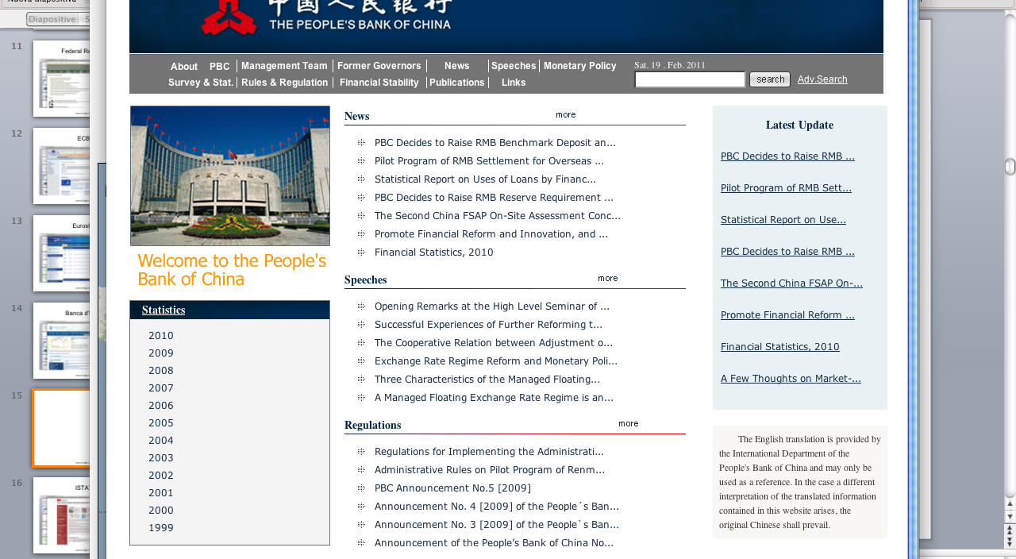
People’s Bank of China

Slide 17
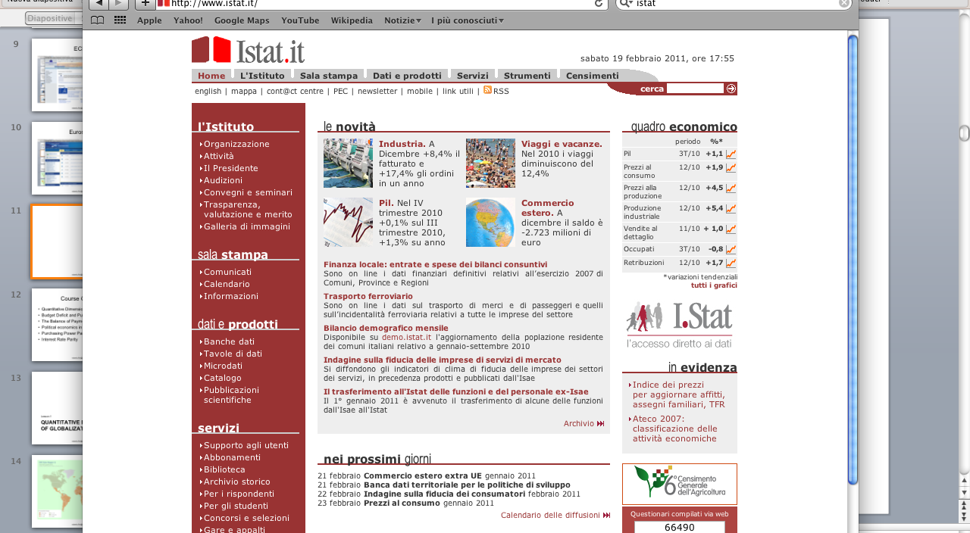
ISTAT

Slide 18
GDP: The present and next future
Lesson 1
Section 1.3

Slide 19
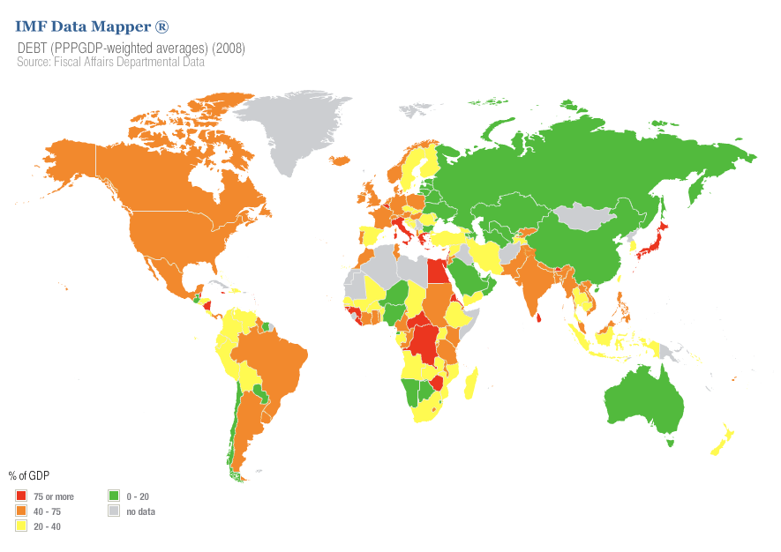

Slide 20
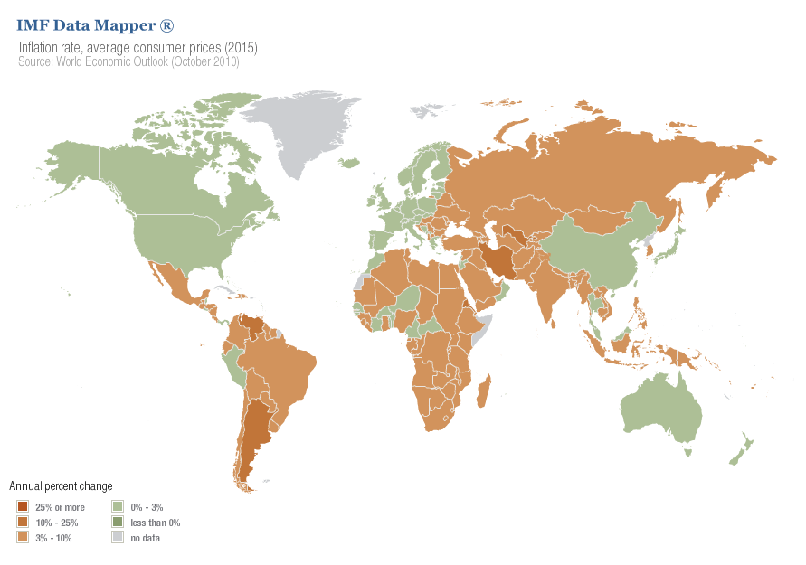

Slide 21
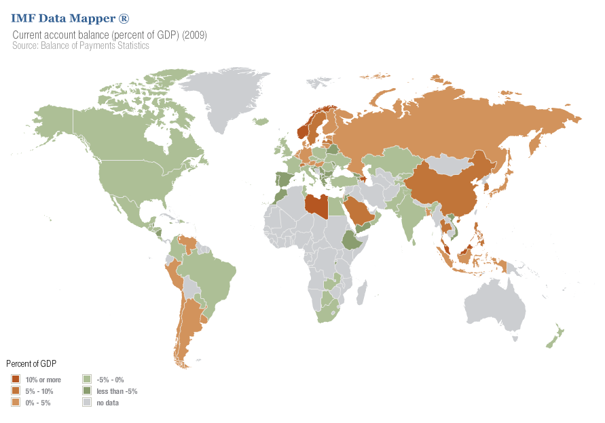

Slide 22
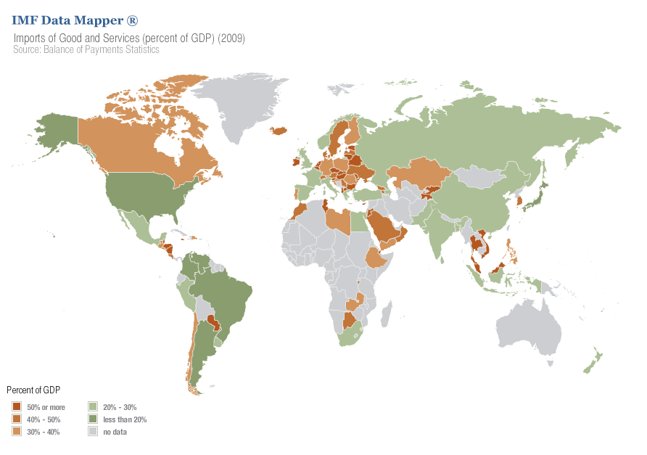

Slide 23
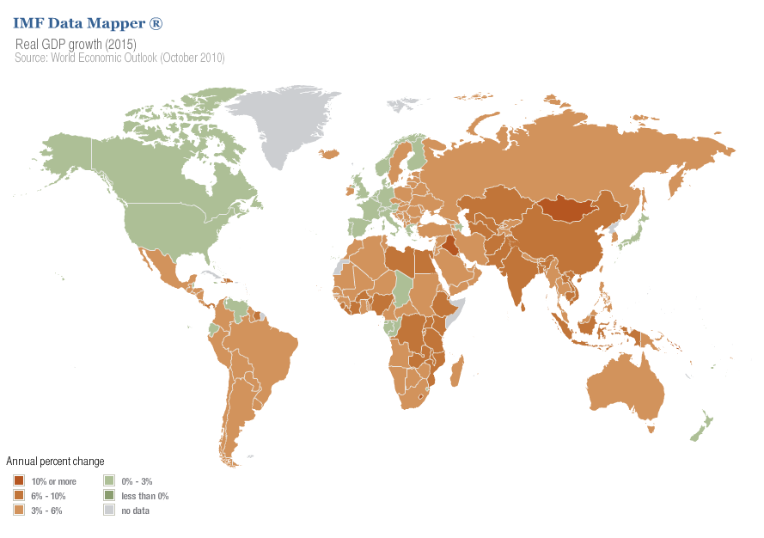

Slide 24
GDP

Slide 25
GDP

Slide 26
GDP

Slide 27
GDP

Slide 28
GDP

Slide 29
GDP

Slide 30
GDP

Slide 31
GDP

Slide 32
GDP: BRICs

Slide 33
GDP: G7 vs BRICs

Slide 34
GDP per capita: Europe (and Canada and Japan) vs USA

Slide 35
GDP per capita: All vs USA

Slide 36
Budget deficit and the National Debt
Lesson 2
Secion 2.1: Introduction

Slide 37
Upon completion of this chapter you should
  know what's involved in calculating the structural deficit, a deficit measure designed to provide a more accurate view of the extent to which we should worry about the size of the deficit; and
  recognize the circumstances in which an increase in the national debt can be viewed as a burden on future generations.

Slide 38
When government spending exceeds tax revenues, there is a government budget deficit, which is financed by selling bonds.
The sum of all outstanding government bonds is called the national debt, which grows each year by the amount of the budget deficit. (It would shrink if there were a budget surplus.)
Some bonds are sold to the central bank, an agent of the government, so this part of the national debt the government owes to itself; consequently, nobody worries about it.
The remaining bonds are sold to the public, augmenting the publicly held national debt

Slide 39

An important legacy of Keynes is that budget deficits became respectable side effects of efforts to keep an economy operating at full employment.
Keynes's intention was that deficits required to stimulate the economy when it is in recession would be offset by budget surpluses in times of full employment, ensuring that in the long run the national debt would not continually grow.

Slide 40
Budget deficit and the National Debt
Lesson 2
Section 2.2 : Recall on AD

Slide 41
AD
AD₃
AD₂
AD₁
Y
Y₁
Y₂
Y₃

Slide 42
AD
AD*
AD₃
AD₂
AD₁
Y
Y₁
Y₂
Y₃
Y*

Slide 43
AD
AD*
C + I
C
AD_{c+I}
AD_{c}
C₀+I₀
C₀
I₀
I
Y
Y_{C}
Y_{C+I}
Y*

Slide 44
AD
C + I + G
AD*
C + I
C
AD_{c+I}
AD_{c}
C₀+I₀
C₀
I₀
I
Y
Y_{C}
Y_{C+I}
Y*

Slide 45
Budget deficit and the National Debt
Lesson 2
Section 2.3: Budget deficit (causes and effects)

Slide 46
Growing deficit responsabilities
Three main culprits were responsible for the growing deficit
1. Tax decreases.
  The ratio of tax revenue to GDP is about 30 percent in the United States, the lowest of all OECD countries. Canada's ratio is about 40 percent, and Sweden's is about 50 percent.
2. Growing entitlement expenditures.
  Social Security and Public Health Service expenditures cannot easily be controlled because anyone eligible is entitled to coverage. As our population ages, spending in these two categories continually increases, with politicians refusing to increase taxes to pay for it.
3. Higher interest payments.
  Because of higher interest rates and a higher national debt, interest payments as a fraction of government spending have jumped from about 9 percent to about 13 percent. Recent decreases in interest rates have alleviated this burden considerably.

Slide 47
Budget deficit: costs and benefits
Budget deficits carry both costs and benefits for the economy. Any assessment of their desirability must weigh these costs and benefits carefully.
  1. Lower unemployment
  2. Public investment
  3. Lower national saving
  4. International implications
  5. Debt monetization
  6. Growing national debt

Slide 48
Especially, growing national debt.
  Continued budget deficits increase the national debt. A growing national debt has several important implications:
    a. A growing national debt means growing interest payments on that national debt. Over time, the interest payments may become a sufficiently large fraction of the government's financing needs that they render fiscal policy inflexible. Fiscal policy to attack unemployment, for example, may not be undertaken because financing is not available.
    b. A growing national debt inevitably means that tax rates rise as much as politicians dare, to facilitate handling the high interest payments. Tax increases create disincentive effects, as emphasized by the supply-siders.
    c. A growing national debt means that we may be placing a burden on future generations who will inherit that debt. Many view this practice as morally wrong. d. A national debt could grow to the point where it will become too large for the country to service, causing a major crisis in the economy. One way of measuring whether an economy is headed in this direction is to calculate the structural deficit.

Slide 49
The structural deficit is the part of the current budget that in the long run increases the ratio of the publicly held national debt to nominal GDP.
Three adjustments must be made to the current budget deficit to calculate the structural deficit:
  1. A correction is needed for cyclical effects that hinder the current deficit's ability to reflect any long-run trend accurately. For example, if GDP drops below its long-run trend average by $100, it is estimated that tax receipts fall by $25 and government spending on transfers increases by $8, so that $33 of the deficit does not correspond to long-run behavior. It should be noted that there is not a universal definition of the structural deficit. Some textbooks define it as involving only this cyclical adjustment.
  2. A correction is needed for real growth and inflation because if nominal GDP is growing the publicly held debt can grow without affecting their ratio.
  3. A correction is needed for seigniorage. Each year, an increase in the money supply is required to accommodate money demand increases, allowing the government to finance some of its deficit by printing money. This financing does not affect the publicly held debt.

Slide 50
Correction for cyclical effects
  The economy is currently experiencing an unemployment rate greater than its long-run average, so part of the current deficit does not reflect the long-run contribution of the deficit to the national debt.
Correction for nominal growth
  Nominal GDP—the denominator of the ratio of the publicly held debt to GDP—is growing, so the numerator can grow at the same rate without increasing this ratio
Correction for seigniorage.
  Each year the central bank increases the money supply to accommodate the economy's nominal growth. This increase allows some of the deficit to be financed by selling bonds to the central bank (printing money) rather than to the public. These bond sales do not affect the publicly held debt and thus do not affect the ratio of the publicly held debt to GDP

Slide 51

Budget deficit and future generations
The question of whether a burden is being passed on to future generations is best addressed by examining the capital stock that is being passed on at the same time. Let us examine this issue first by assuming only domestic borrowing and second by assuming borrowing from foreigners

Slide 52
Domestic budget deficit
If the borrowing is domestic, then we owe the debt to ourselves, and it seems that overall there is no intergenerational burden.
This reasoning is misleading, however.
Domestic borrowing to finance a deficit crowds out some investment spending.
If the deficit spending is on capital assets such as roads and airports, it is possible that the capital stock passed on to the future generation is of more value than the investment spending that is crowded out

Slide 53
Budget deficiti for foreigners
The great advantage of borrowing from foreigners is that crowding out can be avoided.
The foreign exchange obtained by the borrowing can be used to import more goods and services, allowing the economy to have extra output to distribute to its citizens.
In this case, however, future generations must pay interest and principal to foreigners, so it looks as though they are being burdened.
Once again, though, this conclusion depends on the nature of the deficit spending. If the government has borrowed to invest in social infrastructure that increases the economy's productivity by enough to create additional annual income sufficient to pay off the interest and principal of the debt, then the deficit cannot be said to burden future generations.

Slide 54
Budget deficit and the National Debt
Lesson 2
Section 2.4: the Twin Deficit

Slide 55
USA

Slide 56
China

Slide 57
Germany

Slide 58
Italy

Slide 59
India

Slide 60
Japan

